Slide 1
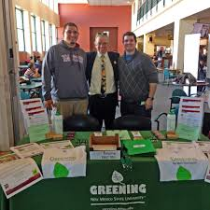
How to use HORIVERT to consult to NMSU Recycling System
David M. Boje
Mgt 448 & 548
Sept 12, 2018

Slide 2
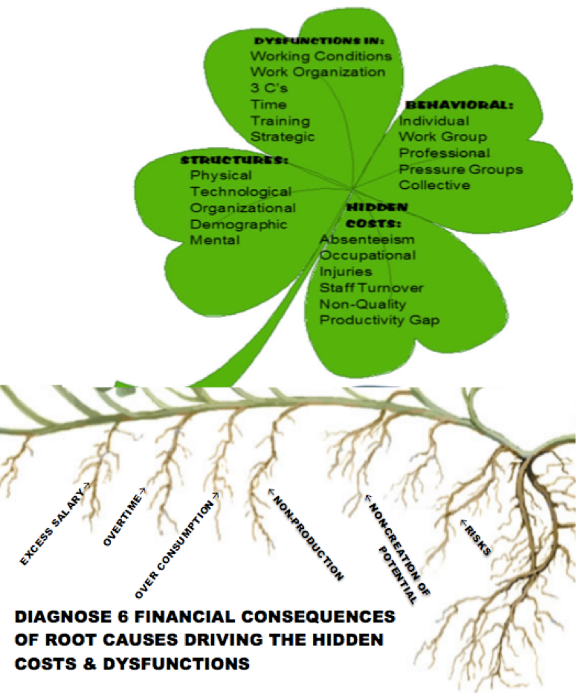

Slide 4
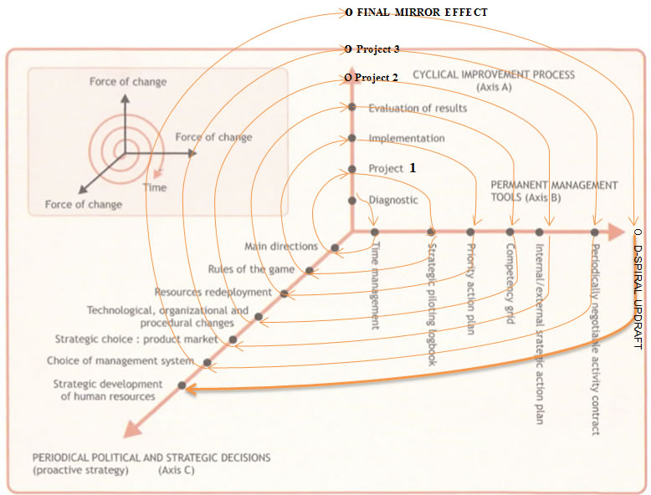

Slide 5
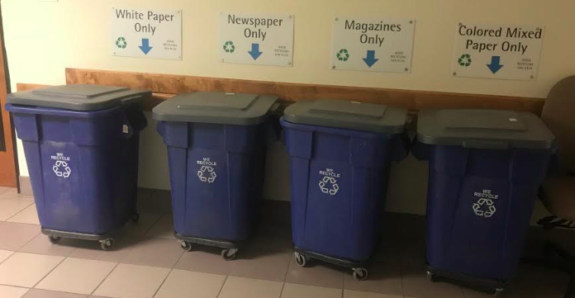
The BEFORE – stations like this on 1st & 3rd floor Business Complex building
Sep 11 2018 Photo of Hadley Hall basement 4 bin recycling station

Slide 6
AESTHETIC NARRATIVE of ‘Beauty’ versus Counternarrative ‘Recycling functional and Green
Across Campus in a growing number of buildings, the 4 BIN BIG BLUE recycling system is being dismantled, removed, reduced to two, one, or no recycling bins at all
Spoke to Recycing managers and workers -→ Building Monitors in Business College telling them to dismantle the ‘recycling eyesore’ to beautify college for students and visitors
⬅ IS THIS UGLY OR BEAUTIFUL

Slide 7
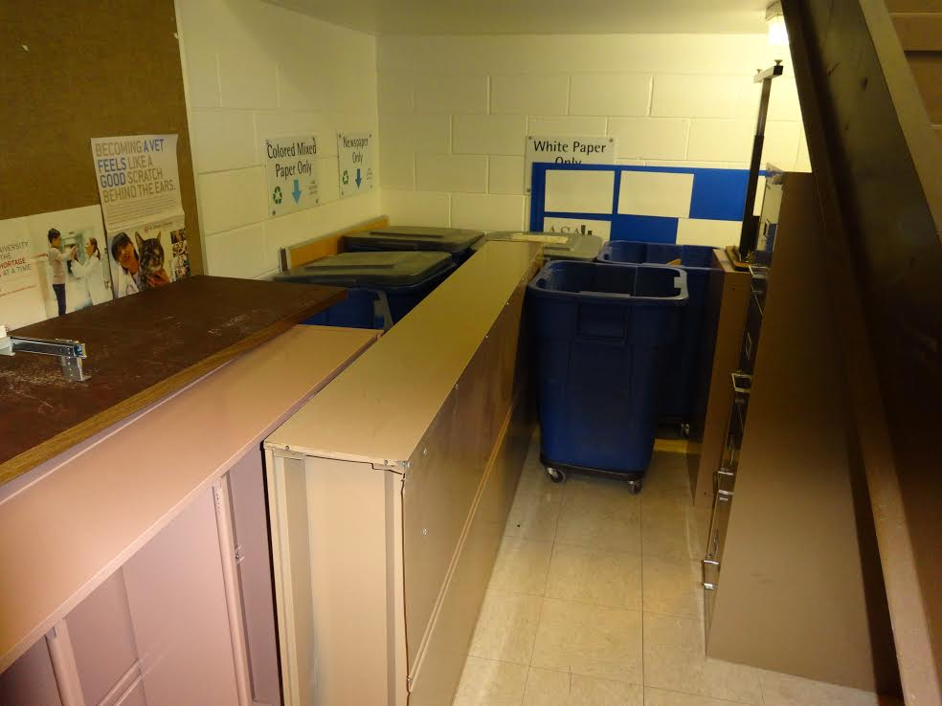
THE NOW of Business Complex building with bins moves 1st floor lobby and third floor locations to beneath the first floor stairwell & no such stations in Guthrie or Domenici buildings
THINGS TELL A STORY
Observe the Micro-Spaces of THINGS telling a story

Slide 8
What is HORIVERT?
It is a structured intervention method of in-depth, progressive transformation using DPIEs
SIMULTANEOUS Horizontal and Vertical action:
Negotiating the intervention with Top Management participation of NMSU
Adapting the intervention to the NMSU college structure, the facility & services structure, and to student culture?

Slide 9
The Working Organization of Custodial and Solid Waste/Recycling
Custodial Services is responsible for the daily cleaning of our campus classrooms, offices, common areas, and entry ways. They also promote sustainability collecting the campus recycling from the common area collection points as well as the desk side collection in offices. If you would like more information about this group please contact Art Lucero at 646-8159 or visit the Custodial web page.

Slide 10
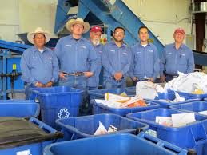
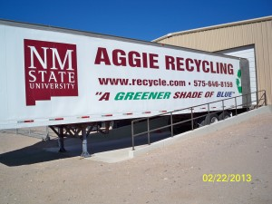
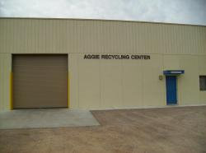
NMSU Recycling crew
Once upon at time a crew of 6 plus 3-4 student workers sorted the RECYCLING, but now only 2 Facilities & Service people and volunteer students (now and then) getting credit for service learning projects DO IT ALL!

Slide 11
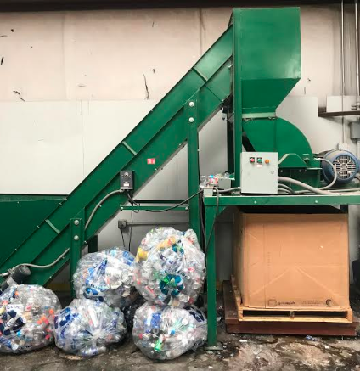
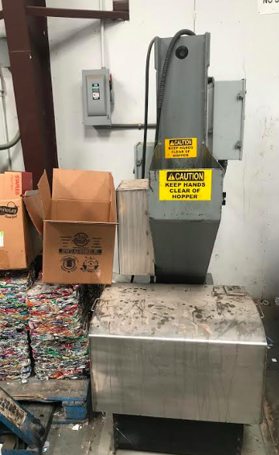
ABOVE is plastic bottle shredder (after the lids and rings taken off), and RIGHT is aluminum can smasher (see cubes under box)

Slide 12
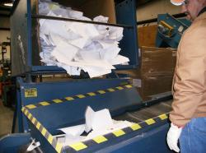
Hierarchical Superiors Art Lucero (recycling) to VP of ‘Facilities & Services, Recycling Manager, Provost, Chancellor, President
NMSU has developed a recycling program to comply with The State of New Mexico’s mandate for all institutions of higher education to divert 25 percent of their waste. Aggie Recycling is an integrated solid waste management program focused on recycling, reduction, and improved handling of campus-generated solid wastes.
Office Information
Hours of Operation
4:00 AM – 12:30 PM
Physical Location 1530 Wells St.
ART LUCERO
Phone: (575) 646-8159 Email: artl@nmsu.edu Recycling Business Hours
Monday-Friday 6 am- 2 pm
Off weekends and holidays

Slide 13
Recycling Services
Implementation of a comprehensive recycling effort has resulted in substantial amounts of paper, metal, and organic materials being diverted from the campus waste stream. Aggie Recycling provides the following services:
Containers for the collection of recyclables
Weekly pick-ups
Special pickups as needed
Drop-offs accepted
(Recycling Center located across from the Bookstore Warehouse)
Organics Recycling

Slide 14
Begin HORIVERT with a top down negotiation
E.g. Sent Art Lucero, recycling manager, a summary of the situation, and the project
This is working through the university HIERARCHICAL CHANNELS (decending approach)
The bottom up (ascending) approach is to work with students, janitors, staff, faculty, and the executive committee (dean, associate dean, development officer, & department heads, etc.) of the Business College
HORIVERT links the decending and the ascending

Slide 15
Horizontal/Vertical Action
Horizontal Action – involves the Executive Management Team of Recycling at NMSU (VP & Associate VP for Facilities & Services Glen Haubold; Recycling Manager Art Lucero; joni newcomer (Manager Office of Sustainability, & Chair of Sustainability Council) in a HORIZONTAL DIAGNOSIS focus group see SOURCE
Vertical Action – involves at least two units (e.g. Business College Administration, Faculty, Staff, & Business Students). VERTICAL DIAGNOSIS Focus group in each of 3 buildings of Business College.
Notes:
https://newscenter.nmsu.edu/Articles/view/12957/nmsu-facilities-and-services-associate-vice-president-to-present-research-in-washington-d-c

Slide 16
Progressive involvement of actors in Diagnosis, Project Design, Implementation, and Evaluation (DPIE)
Several DPIEs crates a “ripple-through process” (p. 103), a series of experiments to bring about wider results
Progressive extension of their fields and involvement of actors, structured into stages
Bring about greater economy of scale
Promoting more internal dissemination

Slide 17
RAPID INTERVENTION RHYTHMS
Horivert – diagnostic focus groups, develop the priority of the project, and the involvements in the intervention experiments.
Several DPIEs in rapid succession develop the momentum of the intervention in number of pilot actions

Slide 18
Arizona State RECYCLING PROGRAM
Compost – If you want to coordinate a composting program in your unit, submit a request.
Ensure your office has recycling signs and labels (link to sign page).
Lead an office cleanout.
Pair recycling and landfill bins side-by-side. Fill out a request form for additional blue bins.
Participate in the commingled recycling program.
Place a Blue bag in common areas to collect specialty items.
Sign up for secured document shredding and recycling.

Slide 19
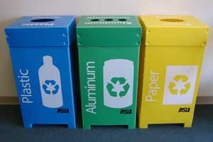
Come up with recycling ideas for NMSU
Recycling inspector gives out OOPS tags for classrooms and buildings with recyclable contamination
Replace the Waste-bins in classrooms with color coded recycling system E.G.

Slide 20
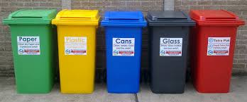
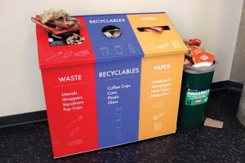
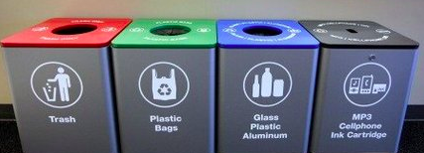
More color coded bin systems

Slide 21
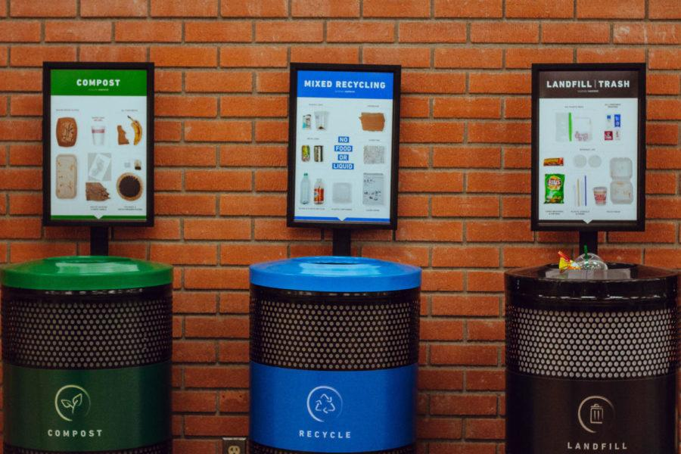
Colorado State University RECYCLING SYSTEM

Slide 22
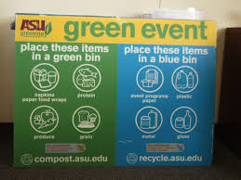
ASU BLUE BIN PAGE & COLOR CODED BIN SYSTEM
https://cfo.asu.edu/blue-bin
Get a clearer signage system at NMSU for recycling

